Slide 1
Text Classification Using Machine Learning Algorithms -Guided By Prof Mahesh Shirole
Project By:
151080004 Sanket Dhabale
151080007 Pranay Manthanwar
151080056 Pankaj Dandewad
151080057 Chetan Ghodam

Slide 2
Abstract:
Idea of predicting and classification of documents
Based on various features
Generating labels for the list of documents.
Classify the documents accordingly and generate a specified class for the dataset.
Need to explore the fields of Machine Learning and provide an appropriate data classification model.
Most of the dataset is text based
Many Algorithms would be the perfect to predict and classify the documents according to the expected and actual output.

Slide 3
Introduction:
Since the age of internet many of the sports, businesses, advertisement companies, political matters, documents are released
Different languages
Quite difficult to predict their documents type or category in which they fall
Land up at an unstable position for their expanding their agendas about the information they are providing.

Slide 4
Project mainly deals with the prediction and classification of the documents
Based on the text document they had provided along with the dataset
More convenient, reliable and also provides the user with wide range of classified and categorized data about the documents.

Slide 5
Train our model to classify text data according to their label and provide the test dataset to the model
Error in the classification can be calculated
Allows our scope to improve the model.
Use of machine learning algorithm that provides appropriate string data classification with maximum accuracy.

Slide 6
Some examples of text classification are:
Understanding audience sentiment from social media,
Detection of spam and non-spam emails,
Auto tagging of customer queries, and
Categorization of news articles into defined topics.

Slide 7
Reasons for Classification:
Increase in the amount of information available online.
With abundance of information in various languages, complexity in classification arises
Text classification is different from binary classification
Not to cause any bias in assigning labels due to multiple classes

Slide 8
Multiple types of documents are present ie. assigning a label to a document is not binary but requires much more computation
To reduce unnecessary consumption of resources like time for classification, man handling, etc

Slide 9
PROBLEM STATEMENT:
Starting from the internet age, many more documents have been flooding over the internet. Lots and lots of documents are found within a minute. Thus assigning a binary class to a document is not preferred and it is not so convenient to do so. Also it is very important to classify these online documents for easy and fast access for computational purposes or finding anything on World Wide Web.

Slide 10
Our proposed system does the job of classifying and labelling a document its accurate class. Along with English text classification, we are also going to consider the Marathi text classification and label the documents perfectly. Two separate databases will be required for the algorithm to understand and classify the document accordingly.

Slide 11
Proposed System:
The solution is divided into two modules.
One module handles the English literature part of the document classification
Another module uses Devnagari script for classifying the Marathi documents.
English language and one Regional language, in this case MARATHI language, can be used for implementing the text document classification.

Slide 12
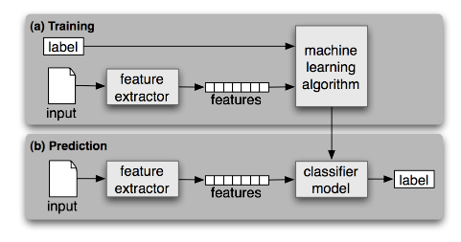
Proposed Architecture:

Slide 13
Steps Involved:
Dataset Preparation: The first step is the Dataset Preparation step which includes the process of loading a dataset and performing basic pre-processing. The dataset is then splitted into train and validation sets.
Feature Selection: The next step is the Feature Selection in which the raw dataset is transformed into flat features which can be used in a machine learning model. This step also includes the process of creating new features from the existing data

Slide 14
3. Model Training: The final step is the Model Building step in which a machine learning model is trained on a labelled dataset.

Slide 15
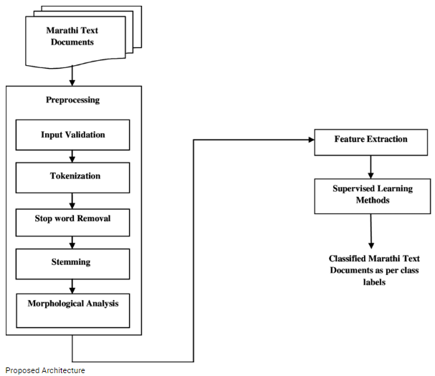

Slide 16
Need for Pre-processing Data:
Incomplete: lacking attribute values, lacking certain attributes of interest, or containing only aggregate data
Noisy: containing errors or outliers
Inconsistent: containing discrepancies in codes or names

Slide 17
Pre-Processing:
Tokenize multi-line comments into single sentences
Make a single sentence of a document
Store it in new document
Tokenize each sentence into words
Generates the token for each and every words
Remove stop words in the tokenized sentence
For a selective language, remove all the stop words

Slide 18
Morphological Analysis :
Aim to recognize the inner structure of the word
Morphological analyzer is expected to produce root words for a given input document
Root and stem of word may differ in their forms
Lemmatize the words in the tokenized sentence
Put the tokenized value instead of word in a sentence to reduce memory consumption
Generate the feature set
All the remaining words will be used for generating the feature set for the classifier model

Slide 19
Stop-Words:
WHY TO REMOVE STOP WORDS:
Reduces the feature space, thus helps in reducing time and space complexity.
Some words are commonly used
Adds no or too less meaning to the content of text.
Lot of CPU cycles and memory can be saved if it is removed in pre-processing phase of text
Gives better result

Slide 20
Stop words:
English language stop word list:
{‘ourselves’, ‘hers’, ‘between’, ‘yourself’, ‘but’, ‘again’, ‘there’, ‘about’, ‘once’, ‘during’, ‘out’, ‘very’, ‘having’, ‘with’, ‘they’, ‘own’, ‘an’, ‘be’, ‘some’, ‘for’, ‘do’, ‘its’, ‘yours’, ‘such’, ‘into’, ‘of’, ‘most’, ‘itself’, ‘other’, ‘off’, ‘is’, ‘s’, ‘am’, ‘or’, ‘who’, ‘as’, ‘from’, ‘him’, ‘each’, ‘the’, ‘themselves’, ‘until’, ‘below’, ‘are’, ‘we’, ‘these’, ‘your’, ‘his’, ‘through’, ‘don’, ‘nor’, ‘me’, ‘were’, ‘her’, ‘more’, ‘himself’, ‘this’, ‘down’, ‘should’, ‘our’, ‘their’, ‘while’, ‘above’, ‘both’, ‘up’, ‘to’, ‘ours’, ‘had’, ‘she’, ‘all’, ‘no’, ‘when’, ‘at’, ‘any’, ‘before’, ‘them’, ‘same’, ‘and’, ‘been’, ‘have’, ‘in’, ‘will’, ‘on’, ‘does’, ‘yourselves’, ‘then’, ‘that’, ‘because’, ‘what’, ‘over’, ‘why’, ‘so’, ‘can’, ‘did’, ‘not’, ‘now’, ‘under’, ‘he’, ‘you’, ‘herself’, ‘has’, ‘just’, ‘where’, ‘too’, ‘only’, ‘myself’, ‘which’, ‘those’, ‘i’, ‘after’, ‘few’, ‘whom’, ‘to’, ‘being’, ‘if’, ‘theirs’, ‘my’, ‘against’, ‘a’, ‘by’, ‘doing’, ‘it’, ‘how’, ‘further’, ‘was’, ‘here’, ‘than’}

Slide 21
Marathi language stop word list:
{ अधिक, अनेक, अशी, असलयाचे, असलेल्या, असा, असून, असे,आज, आणि, आता, आपल्या, आला, आली, आले, आहे, आहेत, एक, एका, कमी, करणयात, करून, का, काम, काय, काही, किवा, की, केला, केली, केले, कोटी, गेल्या, घेऊन, जात, झाला, झाली, झाले, झालेल्या, टा, डॉ, तर, तरी, तसेच, ता, ती, तीन, त, तो, त्या, त्याचा, त्याची, त्याच्या, त्याना, त्यानी, त्यामुळे, त्री, दिली, दोन, न, नाही, निर्ण्य, पण, पम, परयतन, पाटील, म, मात्र, माहिती, मी, मुबी, म्हणजे, म्हणाले, म्हणून, या, याचा, याची, याच्या, याना, यानी, येणार, येत, येथील, येथे, लाख, व, व्यकत, सर्व, सागित्ले, सुरू, हजार, हा, ही, हे, होणार, होत, होता, होती, होते }

Slide 22
import io
from nltk.corpus import stopwords
from nltk.tokenize import word_tokenize
#word_tokenize splits data or sentences into words
stop_words = set(stopwords.words('english'))
file1 = open("text.txt")
line = file1.read()# Use this to read file content as a stream:
words = line.split()
for r in words:
if not r in stop_words:
appendFile = open('filteredtext.txt','a')
appendFile.write(" "+r)
appendFile.close()

Slide 23
Decision tree:
Algorithm used for predictive purposes
Supports multi class label classification
Easy to train and analysis
Uses supervised learning methods like Classification and Regression
Concept like information gain and entropy is used for predicting the value
Contain leaf nodes which determining the class

Slide 24
Random forest builds multiple decision trees and merges them together to get a more and stable prediction
Doesn’t over-fit the dataset
With variant decision trees, we can obtain different results
Random forest takes the average of the outputs and generalizes the single output with highest number of votes or count.
Can be used for both classification and regression problems, which form the majority of current machine learning systems.

Slide 25
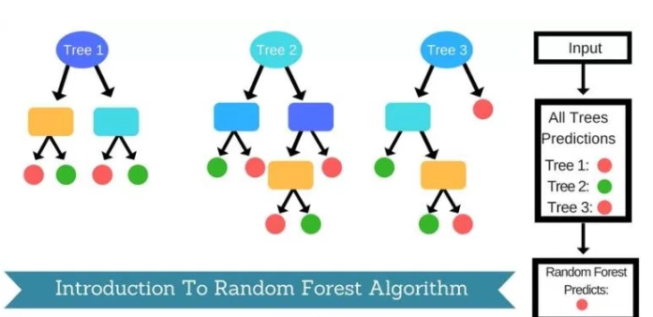
Random Forest diagram:

Slide 26
Appendix:
Experiment:
Input: Text documents
Methodology: Support Vector Machine
Output: Category into which Text documents falls
Summary:
Fully Automated and eliminate the need of manual parameter turing since they can find good parameter settings automatically
Document may fall in multiple, one or more categories
Each category is treated as separate binary classification
Max amount of data pre-processing is done for the learning algorithm SVM
High dimensionality so doesn’t over-fit the data and generalizes accuracy
Eliminates the need of feature selection, thus avoid high computation overload of text categorization
Promising and easy to use algorithm for text categorization

Slide 27
References:
Text Categorization with Support Vector Machines: Learning with Many Relevant Features - Thorsten Joachims
Interaction of Feature Selection Methods and Linear Classification Models - Janez Brank, Marko Grobelnik
An Empirical Comparison of Text Categorization Methods- Ana CardosoCachopo and Arlindo Limede Oliveira
Integrating Feature and Instance Selection for Text Classification- Dimitris Fragoudis,Dimitris Meretakis, Spiros LikothanaSsis
Pruning Training Corpus to Speedup Text Classification- Jihong Guan, Shuigeng Zhou
Accuracy improvement of automatic text classification based on feature transformation and Multi-classifier combination - Xuexian Han Guowei Zu, Wataru Ohyama1

Slide 28
Combining Multiple K-Nearest Neighbour Classifiers for Text Classification by Reducts- Yongguang Bao and Naohiro Ishii
Feature Selection using Improved Mutual Information for Text Classification - Jana Novovicova , Antonon Malik and Pavel Pudil
Discretizing Continuous Attributes in AdaBoost for Text Categorization- Pio Nardiello, Fabrizio Sebastiani, and Alessandro Sperduti
A comparative study on feature selection in text categorization- Yaming Yang, Jan O Pederson

